Slide 1

Hotel Bookings Data Analysis
HOTEL BOOKING DATA ANALYSIS
Exploratory Data Analysis

Slide 2
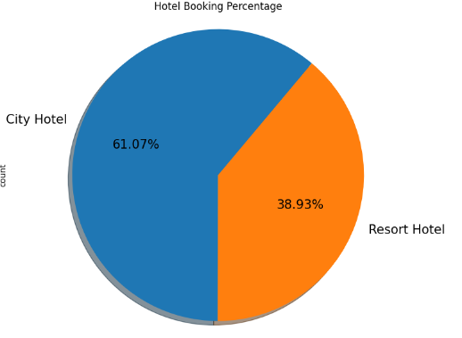
Hotel Bookings Data Analysis
INSIGHTS
Guests prefer Resort Hotel most over City Hotel.
RECOMMENDATIONS
This insight is useful for the stakeholder to check which hotel is performing best and they can invest more capitals in that. There is no such negative growth but stakeholders can focus more on City Hotel to get more booking and icrease the overall revenue.

Slide 3
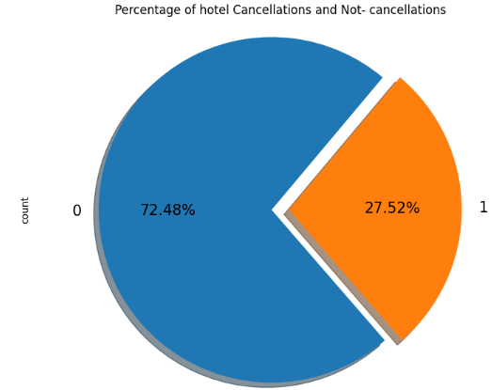
Hotel Bookings Data Analysis
INSIGHTS
Approximately 72.48% of bookings are successfully completed without cancellation, while 27.52% of bookings are canceled by guests.
RECOMMENDATIONS
The high percentage of cancellations suggests the need for more flexible booking and cancellation policies. Offering rescheduling options instead of outright cancellations could help mitigate lost revenue, while a more adaptable cancellation policy may encourage guests to retain their bookings rather than cancel. This approach will allow stakeholders to reduce cancellations and potentially improve booking retention rates.

Slide 4
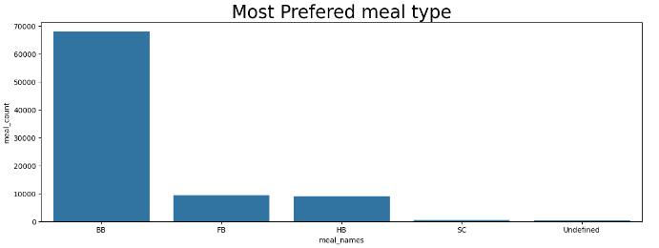
Hotel Bookings Data Analysis
INSIGHTS
The bar chart reveals that the most preferred meal type among guests is BB (Bed and Breakfast). This insight highlights the dominant choice of guests, significantly surpassing other meal options.
RECOMMENDATIONS
Insights will help create a positive business impact. Knowing that BB (Bed and Breakfast) is the most preferred meal option, stakeholders can proactively arrange raw materials and resources to meet demand, ensuring timely delivery of meals and enhancing guest satisfaction.
Meal Type Variable Description:
BB – Bed and Breakfast
HB – Half Board
FB – Full Board
SC – Self Catering

Slide 5
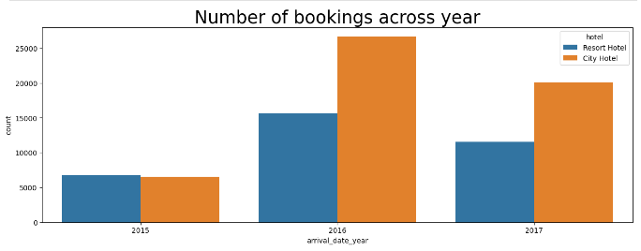
Hotel Bookings Data Analysis
INSIGHTS
The chart reveals that the hotel experienced the highest number of bookings in 2016, with a noticeable decline in bookings in subsequent years.
RECOMMENDATIONS
This insight is crucial for stakeholders as it shows a decline in bookings after 2016, which could be a cause for concern. Understanding what went wrong after 2016 could help reverse this trend. Stakeholders could gather feedback from past guests and hold discussions with employees who were involved during that period to identify potential issues. Addressing these problems could lead to an increase in bookings and positively impact future growth.

Slide 6
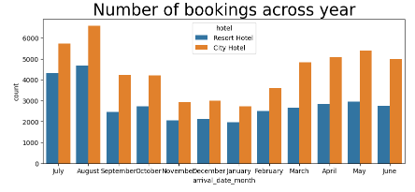
Hotel Bookings Data Analysis
INSIGHTS
The chart reveals that August and July are the busiest months compared to others, indicating a peak in hotel activity during this period.
RECOMMENDATIONS
While there are no negative insights directly, this information can still provide significant value. Knowing that July and August are the busiest months allows the hotel to prepare in advance by ensuring adequate staffing, inventory, and resources to deliver the best possible experience to guests. Additionally, the hotel could launch promotional offers during these months to further capitalize on the increased demand, potentially boosting both bookings and revenue.

Slide 7
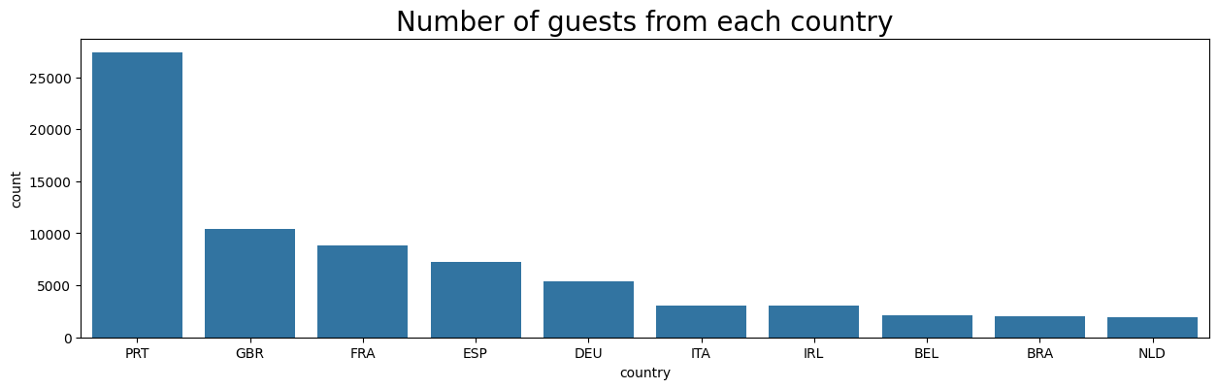
Hotel Bookings Data Analysis
INSIGHTS
The chart reveals that most of the customers come’s from country PRT (Portugal) and less from NLD(Natherland).
RECOMMENDATIONS
Stakeholders needs to do some countries based analysis and compare the business operations work in both the countries and focus more on countries with less customers, Run some discount offers, invest in marketing, etc

Slide 8
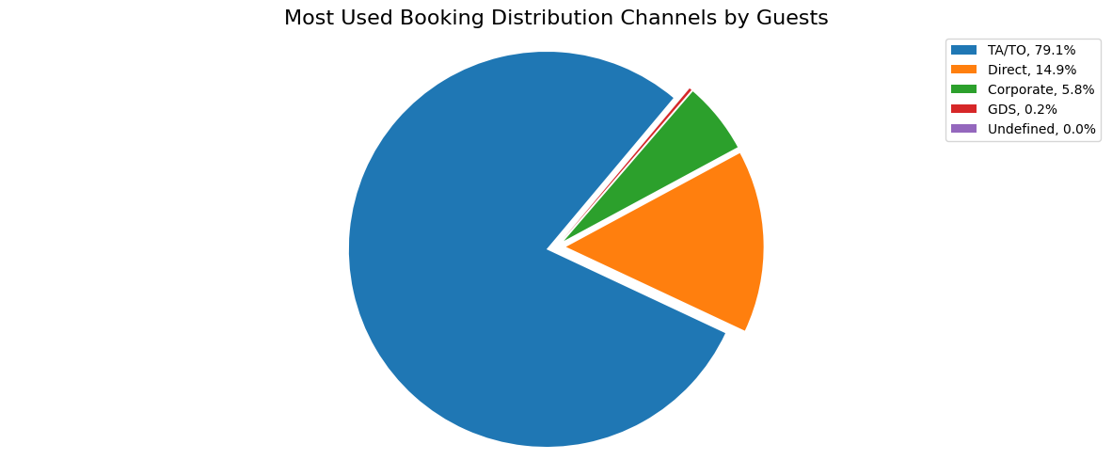
Hotel Bookings Data Analysis
INSIGHTS
The chart reveals that TA/TO (Travel Agents/Tour Operators) is the most commonly used distribution channel by guests, accounting for the largest share of bookings.
RECOMMENDATIONS
There is no immediate negative insight from this data. However, this insight can help the hotel strategically. By recognizing the dominance of the TA/TO channel, the hotel can focus on running promotional offers through other channels to diversify and increase bookings from alternative sources, ensuring a more balanced contribution from all distribution channels.

Slide 9
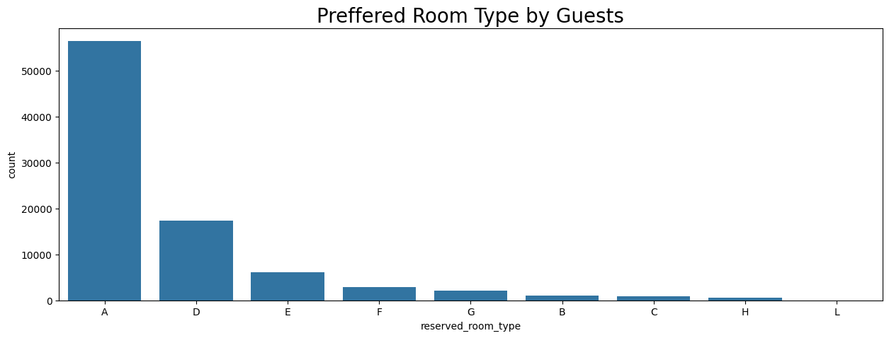
Hotel Bookings Data Analysis
INSIGHTS
The chart reveals that the customers mostly prefer room type A and Room type B,C,H,L are not customer’s choice
RECOMMENDATIONS
This insight presents an opportunity for a positive business impact. Given that Room Type A is the most popular, the hotel can consider increasing the number of Room Type A units to accommodate the high demand. This strategy could help maximize revenue and improve guest satisfaction by meeting their preferences more effectively. Business Have to more focus on room type F, G, B, C, H, L. they have to pay attention on room management and inner operational activities.
They have to implement some discount offers on this rooms.

Slide 10
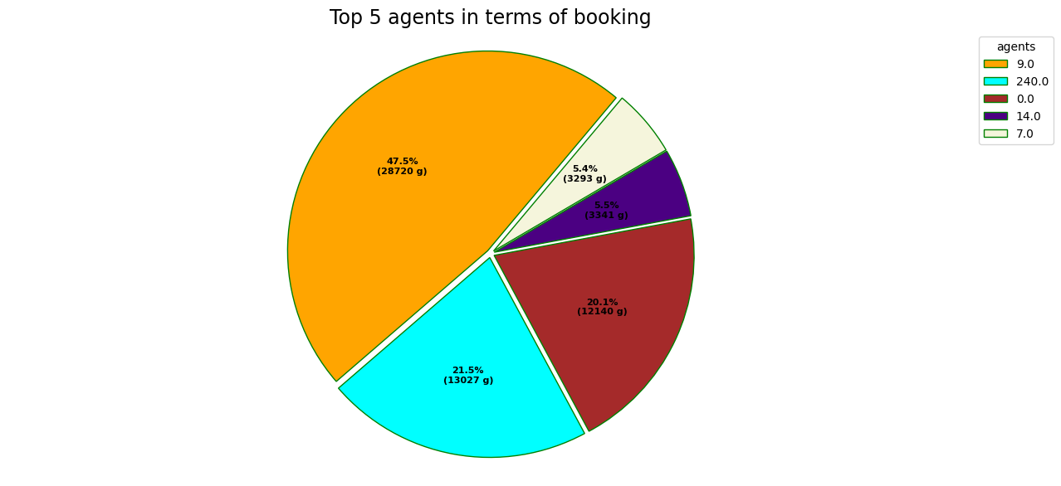
Hotel Bookings Data Analysis
INSIGHTS
The chart reveals that Agent 9 has made the most bookings, followed by Agents 240, 0, 14, and 7, indicating the top contributors to the hotel's booking numbers.
RECOMMENDATIONS
This insight offers an opportunity to create a positive business impact. By recognizing the efforts of the top-performing agents, the hotel can offer bonuses or incentives to these agents as a reward for their excellent performance. This approach will not only motivate them to continue their efforts but may also inspire other agents, leading to an overall increase in bookings and revenue.

Slide 11
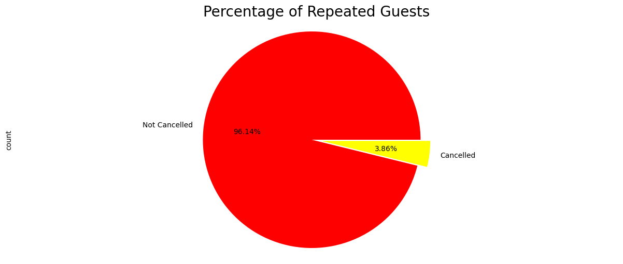
Hotel Bookings Data Analysis
INSIGHTS
Approximatly 95% of customers are revisited to hotel rooms and it’s good for business.
RECOMMENDATIONS
There is no negative impact. Business have to provide some offers to repeated customers to establish family like ralations and make some extra stratagies and plans for customers visit first time so that can visit hotel repeatedly.

Slide 12
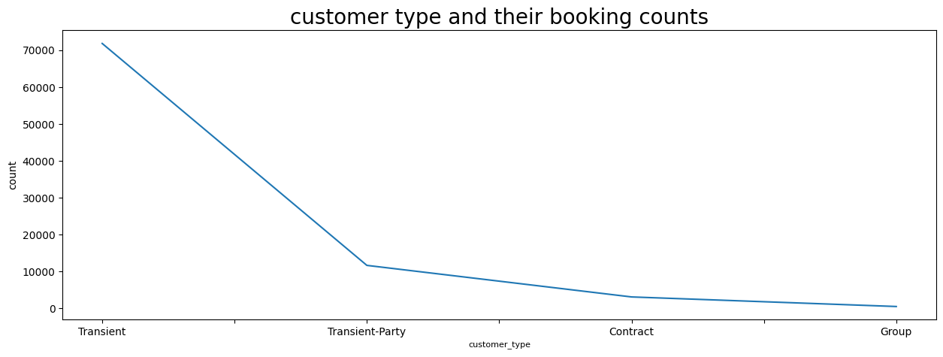
Hotel Bookings Data Analysis
INSIGHTS
Transent customer type has the most bookings approximately 70000 and group type has lowest booking count.
RECOMMENDATIONS
Hotels need to give some extra offers for group customer type to attract them and try to give better service than compititors where most of the group customer types stays.

Slide 13
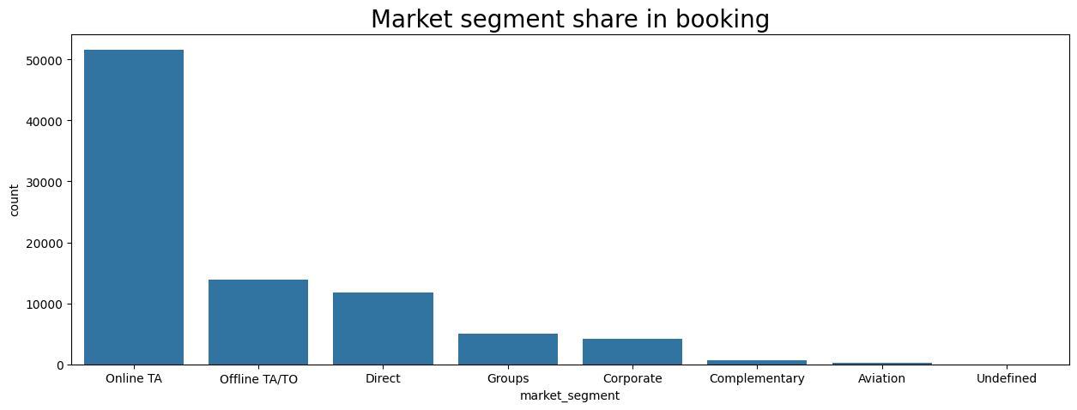
Hotel Bookings Data Analysis
INSIGHTS
Online TA Has the largest market share in bookings.
RECOMMENDATIONS
This insight highlights the significance of Online TA as a key channel for driving bookings. By strengthening partnerships with Online TAs and offering exclusive deals through these platforms, the hotel can further leverage this dominant channel to increase bookings and maximize revenue.

Slide 14
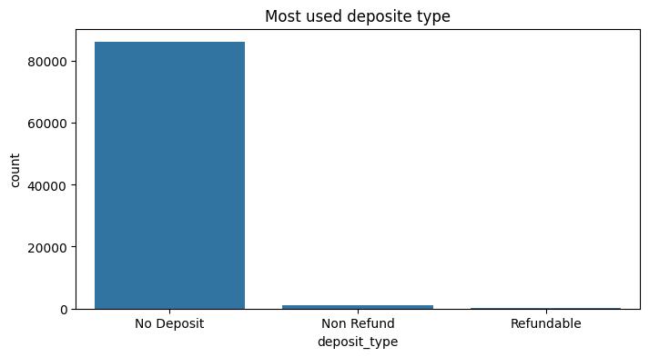
Hotel Bookings Data Analysis
INSIGHTS
Customers prefer No Deposit deposit type approximately all customer prefer this deposit type
RECOMMENDATIONS
Understanding that nearly all customers opt for the No Deposit option allows the hotel to tailor its booking policies accordingly. By promoting flexible, no-deposit booking options, the hotel can attract more customers, increase booking conversion rates, and enhance overall guest satisfaction.

Slide 15
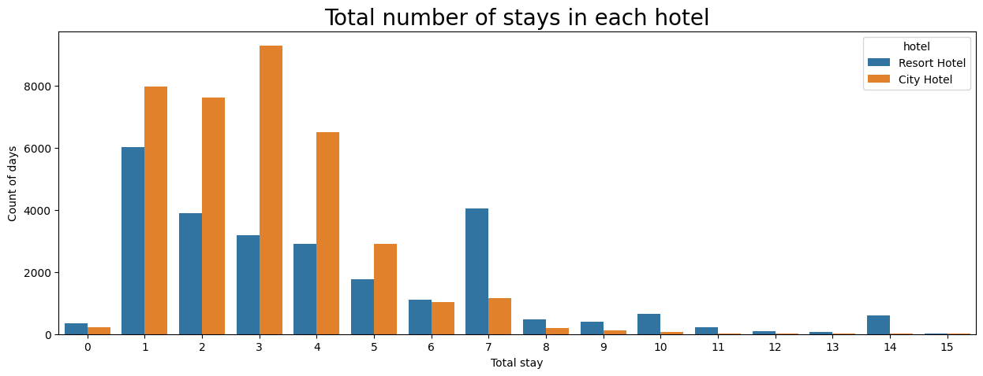
Hotel Bookings Data Analysis
INSIGHTS
Customers mostly prefer city hotel rather than resort hotel.
RECOMMENDATIONS
The Hotel should increase the Number rooms and employes for city hotel.
Businesses Have to more focus onresort hotel to increase there revenue also by running some offers and making them better.

Slide 16
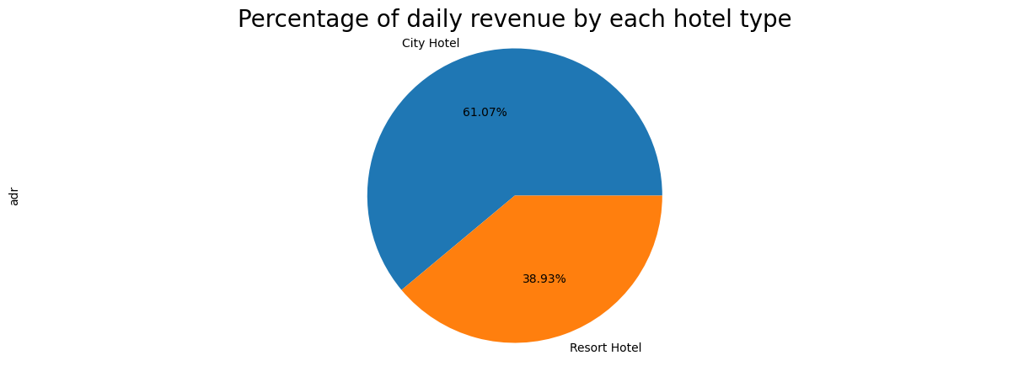
Hotel Bookings Data Analysis
INSIGHTS
61% of the revenue from the daily ravenue comes from city hotel and approx 39% of the daily revenue comes from resort hotels
RECOMMENDATIONS
With city hotels contributing the majority of daily revenue, the hotel can focus on optimizing operations, marketing, and services in city locations to further enhance profitability. At the same time, strategies can be developed to boost resort hotel bookings, such as offering promotional packages or targeting specific customer segments, to create a more balanced revenue stream.

Slide 17
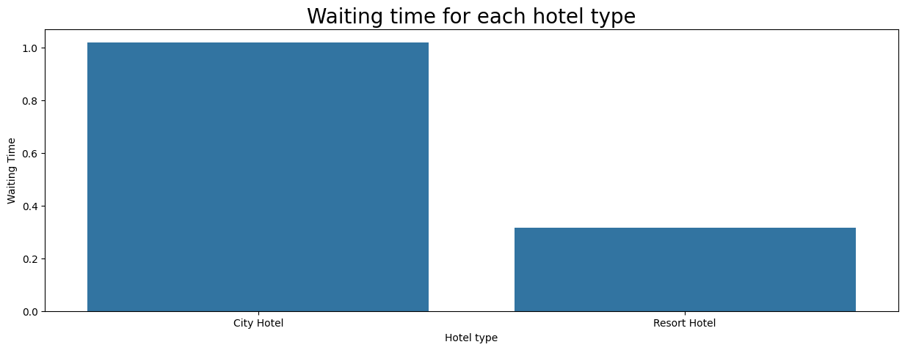
Hotel Bookings Data Analysis
INSIGHTS
The data shows that city hotels have a higher waiting time compared to resort hotels.
RECOMMENDATIONS
The longer waiting time in city hotels could negatively impact guest satisfaction and lead to a potential decline in bookings. To address this, city hotels can optimize their check-in and service processes to reduce wait times, enhancing the guest experience. Implementing solutions such as self-check-in kiosks or improving staff efficiency could help alleviate this issue and improve overall customer satisfaction, leading to increased bookings and loyalty.

Slide 18
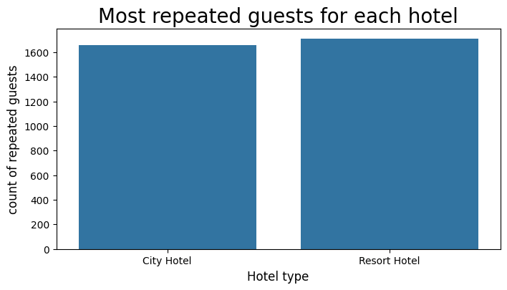
Hotel Bookings Data Analysis
INSIGHTS
The data reveals that city hotels have approximately 1,600 repeat customers, while resort hotels attract around 1,800 repeat customers.
RECOMMENDATIONS
Although resort hotels have a slightly higher number of repeat customers, both city and resort hotels can benefit from strategies to boost customer loyalty. Offering personalized experiences, loyalty programs, or exclusive discounts for repeat guests could further enhance retention rates, leading to increased revenue and customer satisfaction for both city and resort hotels.

Slide 19
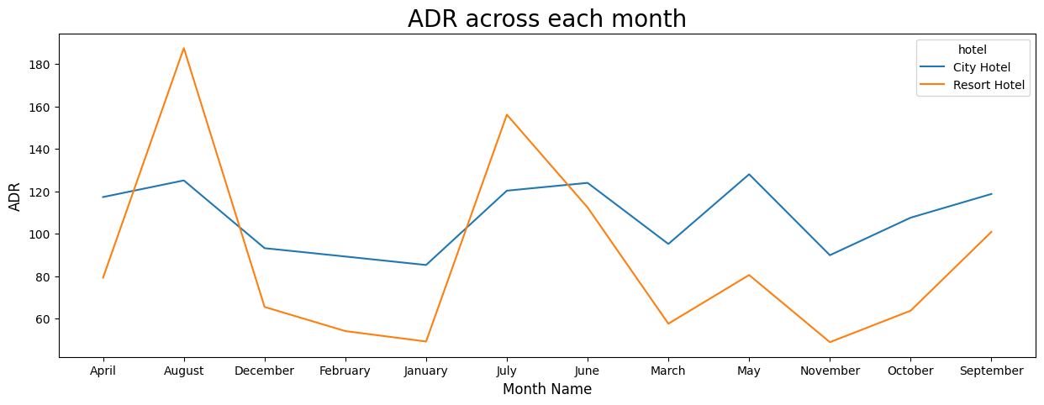
Hotel Bookings Data Analysis
INSIGHTS
For city hotels, the Average Daily Rate (ADR) is highest in August and July, and lowest in January, March, and November. For resort hotels, the ADR peaks in May and August, with the lowest rates observed in January.
RECOMMENDATIONS
Understanding seasonal ADR trends allows the hotel to optimize pricing. During low-ADR months (January, March, November for city hotels; January for resort hotels), the hotel can use promotional offers to attract guests. In peak months (July, August, May), the hotel can maximize revenue by enhancing services and offering premium packages.

Slide 20
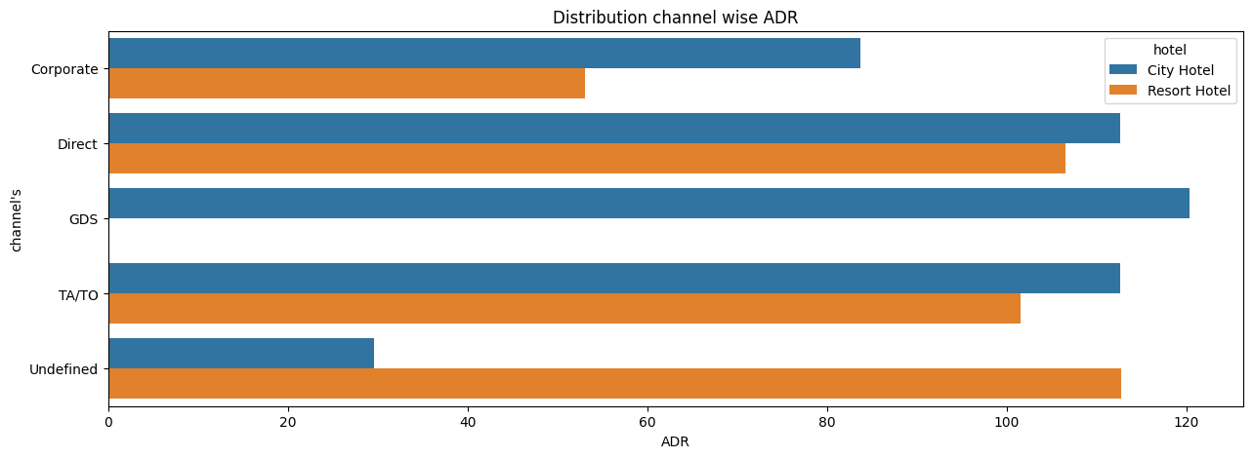
Hotel Bookings Data Analysis
INSIGHTS
The high ADR for resort hotels is driven by channels such as Direct, GDS, and TA/TO. For city hotels, the high ADR comes from Undefined, TA/TO, and Direct channels.
RECOMMENDATIONS
Leveraging these high-performing channels can help the hotel maximize ADR. By focusing on Direct, GDS, and TA/TO channels for resort hotels, and optimizing Undefined, TA/TO, and Direct channels for city hotels, the hotel can enhance revenue and target the most profitable segments.

Slide 21
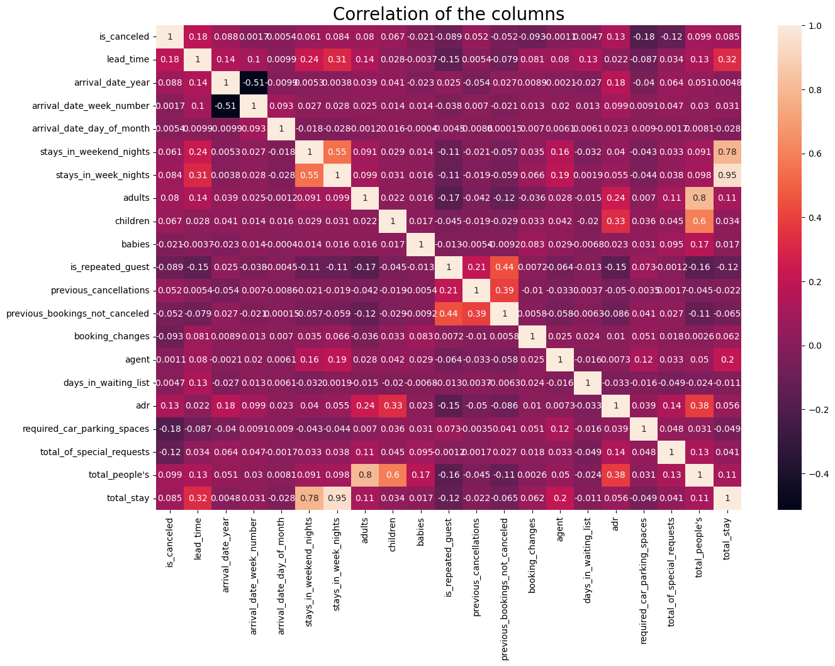
Hotel Bookings Data Analysis
INSIGHTS
The correlation heatmap reveals several key insights: Lead time increases with total stay, indicating that longer stays are associated with longer lead times. There is a correlation between adults, children, and babies, suggesting that a larger number of guests generally leads to a higher Average Daily Rate (ADR). Additionally, repeated guests are strongly correlated with previous bookings not canceled, highlighting that guests who frequently book are less likely to cancel their reservations.

Slide 22
Hotel Bookings Data Analysis
Insights and Recommendation
Resort Hotels vs. City Hotels: Since resort hotels are more preferred, stakeholders should offer discounts for city hotels to boost their bookings
.Around 27.52% of bookings are cancelled so Hotel can offer layalty discount if guests don't cancel their booking.
As Bed and Breakfast (BB) is the most preferred meal type, the hotel should pre-plan and maintain raw materials in advance to avoid delays.
To address high waiting times, the hotel should increase the number of rooms in city hotels.
Since Travel Agents (TA) generate the most bookings, the hotel should consider running offers to attract bookings from other market segments.
Given that Room Type A is most preferred, increasing the number of these rooms could maximize revenue.
The low number of repeated guests suggests potential dissatisfaction. The hotel should investigate and address any issues to improve guest retention.
City hotels experience higher waiting times compared to resort hotels, indicating they are busier. Improving efficiency could enhance guest satisfaction.
With the optimal stay being less than 7 days, the hotel should explore strategies to encourage longer stays.
The majority of guests are from Portugal, indicating a strong market presence that could be leveraged for targeted promotions.

